Slide 1
Jenkins Kubernetes Integration & deploying application(Spring Boot + MongoDB)
- By Mukesh Kumar

Slide 2
This POC covers the below setup:
1. Installation of jenkins,Docker,Maven on jenkins server
2. Installation of kubernetes cluster (As part of this poc 1 master and 1 worker node)
3. Setup jenkins server to deploy application into kubernetes cluster
4. Build and deploy docker Application from jenkins in kubernetes cluster using pipeline script
Purpose: To deploy application into kubernetes cluster integrating with jenkins automation
Technologies used: EC2 instances,Git,jenkins,Maven,Docker,Dockerhub,Kubernetes cluster

Slide 3
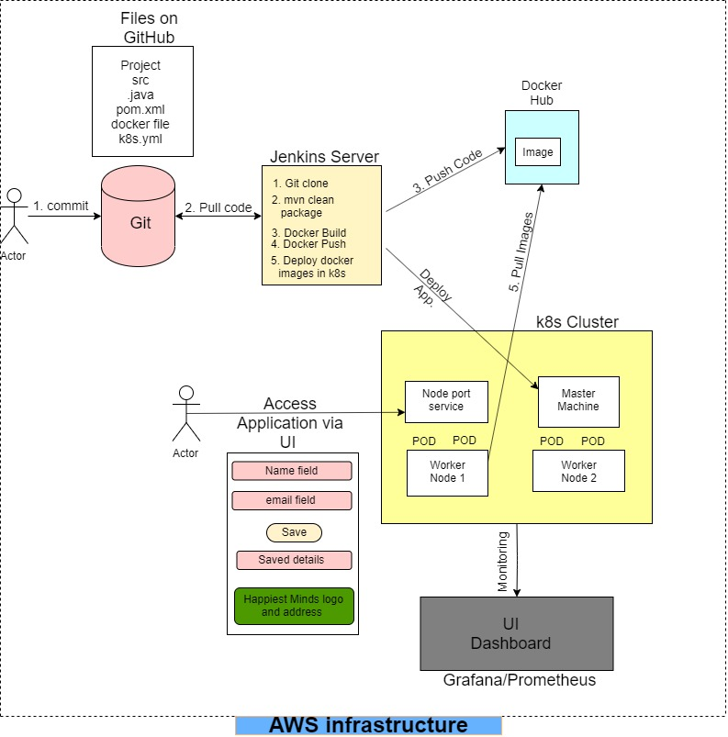
Architecture of application deployment:

Slide 4
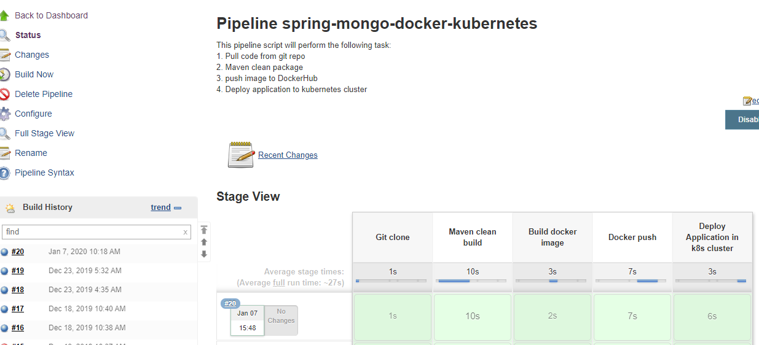
Jenkins pipeline job functionality:
1. Pull code from git repo
2. Maven clean package
3. push image to DockerHub
4. Deploy application to kubernetes cluster

Slide 5
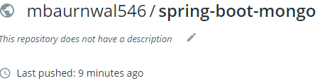
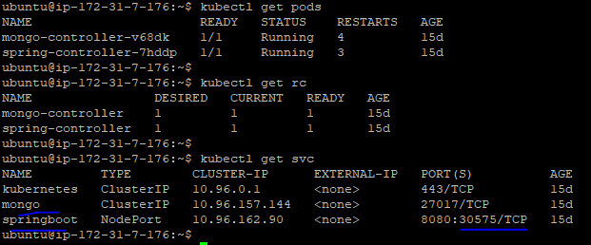
After successful completion of job:
1. DockerHub repository updated with latest build number image
2. Application deployed deployed into kubernetes cluster

Slide 6
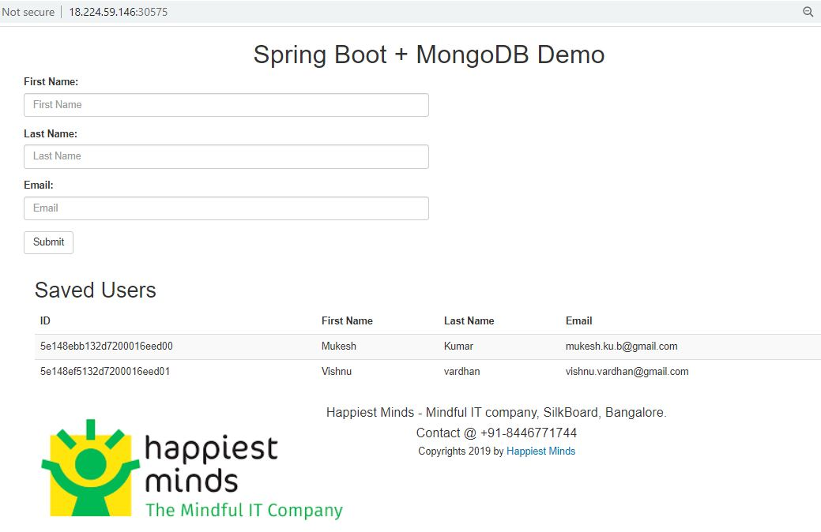
Application UI is accessible:

Slide 7
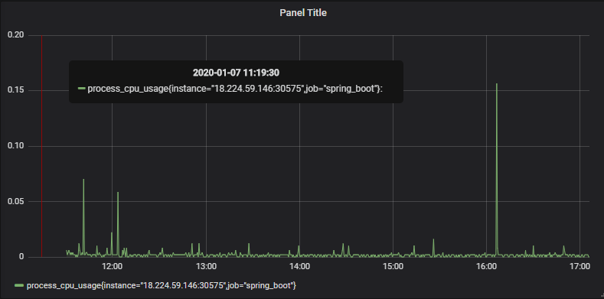
Monitoring of Application and kubernetes cluster:

Slide 8
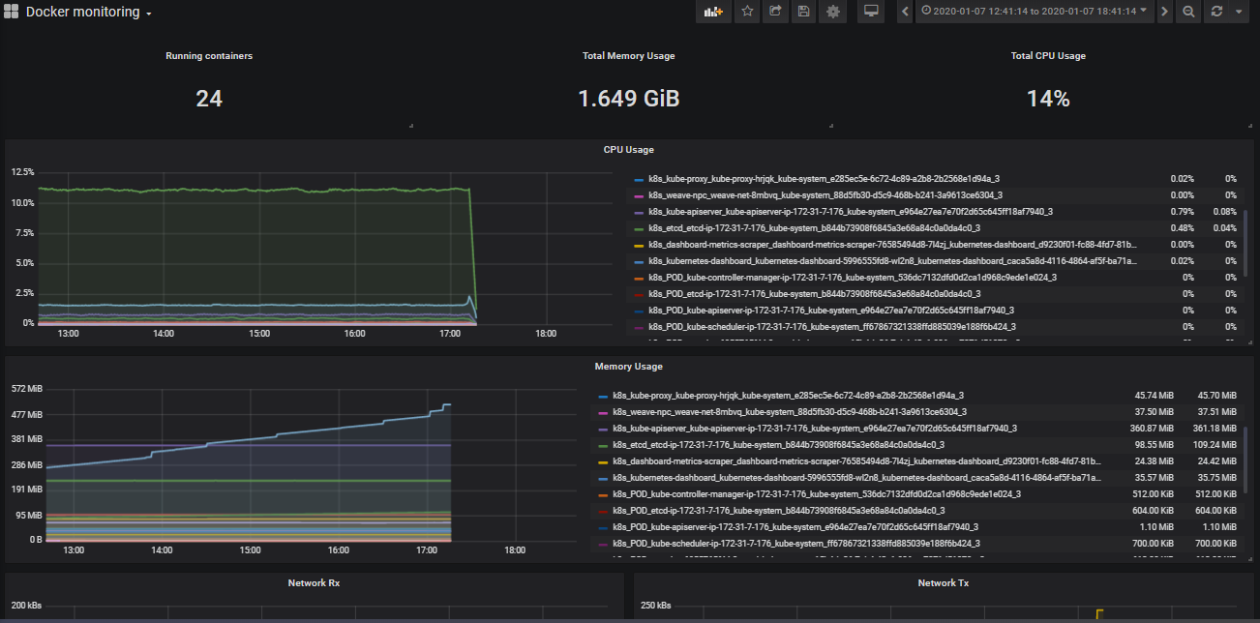

Slide 9
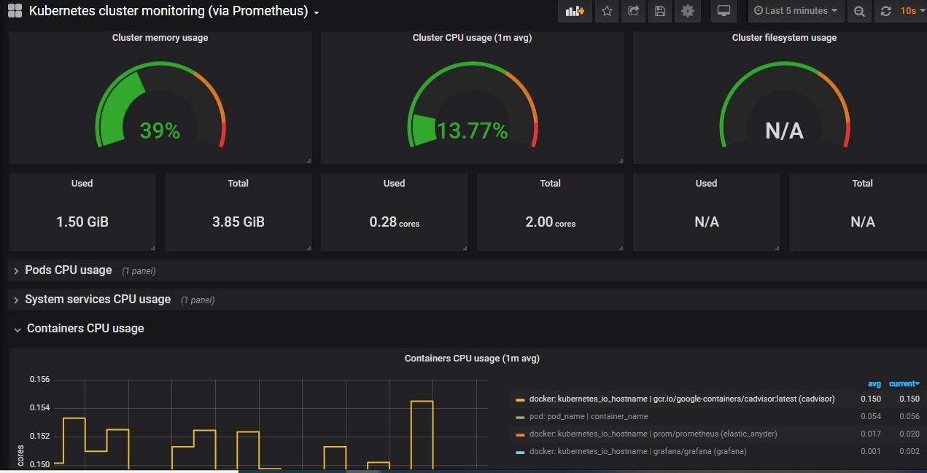

Slide 10

Thank you !!

